Slide 1
Chapter 13: Azure Arc
Instructor-led overview and operational guidance

Slide 2
Learning Objectives
01 Explain what Azure Arc is and what problem it solves
02 Describe Azure Arc-enabled servers and the Connected Machine agent
03 Identify management capabilities Azure Arc adds to on-premises servers
04 Connect a Windows Server 2025 machine to Azure Arc and verify the connection
Windows Server 2025 | Chapter 13 | Azure Arc
02

Slide 3
Chapter Topics
01 13.1 What is Azure Arc?
02 13.2 Azure Arc-enabled servers
03 13.3 Management capabilities
04 13.4 Cost model
05 13.5 Prerequisites and requirements
Windows Server 2025 | Chapter 13 | Azure Arc
03

Slide 4
13.1 What Is Azure Arc?
What Is Azure Arc?
A cloud management service from Microsoft that extends the Azure control plane to any infrastructure
Connects servers running outside Azure so they appear as resources in Azure Resource Manager
Each connected machine gets an Azure Resource ID and can be placed in a resource group
Managed using the same portal, CLI, and APIs used for native Azure VMs
Why Organisations Use It
Manage on-premises and cloud workloads from a single control plane
Apply Azure services (updates, security, monitoring) to servers that stay on-premises
Govern hybrid and multi-cloud environments using consistent Azure Policy
Enable enterprise security on physical servers without migrating to Azure
What Azure Arc Is NOT
Not a migration tool - servers stay where they are
Does not run workloads in Azure - it manages workloads running elsewhere
Not designed for VMs already running natively in Azure
Key Concept
Azure Arc makes non-Azure servers look like Azure resources.
Once connected, a server has:
An Azure Resource ID
An Azure-managed identity
Role-Based Access Control (RBAC)
Support for Azure Policy and tagging
Access to Azure management services
Supported Environments
On-premises physical servers and VMs
Other cloud providers (AWS, GCP)
Edge and remote locations
[Screenshot placeholder: Azure Arc overview page in Azure portal showing Servers, Kubernetes clusters, SQL Servers, Data Services]
Windows Server 2025 | Chapter 13 | Azure Arc
04

Slide 5
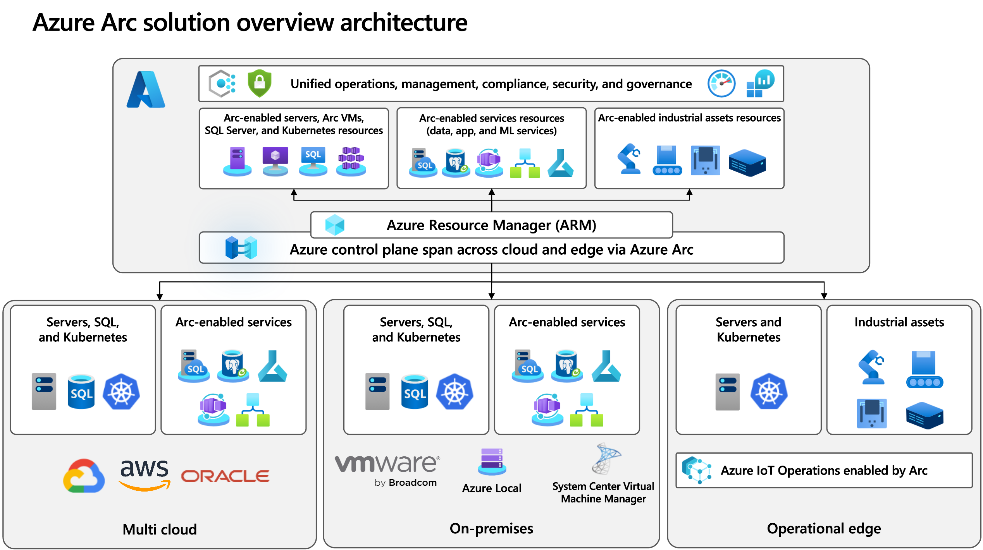

Slide 6
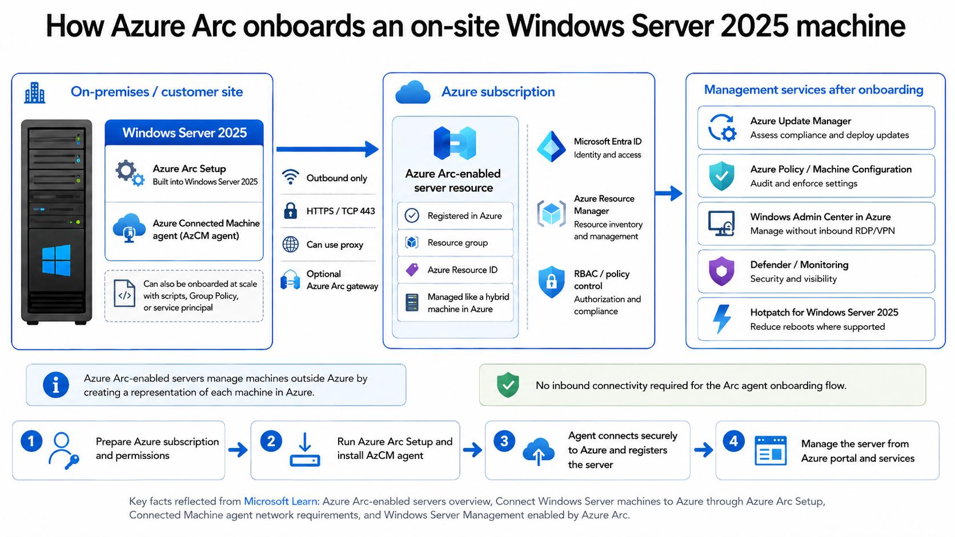
Windows Server 2025 | Chapter 13 | Azure Arc
05

Slide 7
13.2 Azure Arc-Enabled Servers
What Are Arc-Enabled Servers?
Windows and Linux machines running outside Azure that are registered with Azure Arc
Connection is established by installing the Azure Connected Machine agent on the server
Once registered, the server appears in Azure portal under Azure Arc > Servers
The machine is treated as a hybrid resource alongside native Azure VMs
The Azure Connected Machine Agent
Installed as Windows services - the core service is himds (Hybrid Instance Metadata Service)
Manages the secure connection to Azure and the machine's managed identity
Sends a heartbeat to Azure every 5 minutes to confirm the server is online
If heartbeat is lost for 15-30 minutes, status changes to Disconnected
Low resource footprint: approximately 0.07% CPU and 57 MB memory under normal conditions
Agent Status Values
Connected - agent running and communicating normally with Azure
Disconnected - heartbeat lost for 15-30 minutes
Expired - disconnected for more than 45 days; reconnection required
Windows Services Installed
# Verify all agent services are running
Get-Service himds, GCArcService,
ExtensionService |
Select Name, Status
Check Agent Connection
# Show full Arc connection status
azcmagent show
Agent Version
azcmagent version
Key Service: himds
Hybrid Instance Metadata Service. Manages the Azure connection and issues identity tokens to extensions. Must always be Running.
Windows Server 2025 | Chapter 13 | Azure Arc
06

Slide 8
13.3 Management Capabilities
Govern
Assign Azure Policy to audit and enforce configuration inside connected machines
Define compliance rules: password policy, encryption, admin group membership
Organise servers with Azure resource groups, management groups, and tags
Query and inventory all connected servers with Azure Resource Graph
Protect
Enable Microsoft Defender for Servers via Microsoft Defender for Cloud
Threat detection, vulnerability scanning, and security recommendations
Integrate with Microsoft Sentinel to collect and correlate security events
RBAC controls who can view and manage each connected server from Azure
Configure
Run PowerShell or Python automation using Azure Automation runbooks
Track configuration changes: software, registry, services, and files
Deploy and manage VM extensions from the Azure portal or CLI
Manage OS updates for connected servers using Azure Update Manager
Monitor
Collect performance and event data with Azure Monitor Agent
Send logs to a Log Analytics workspace for analysis and alerting
Use VM Insights to monitor OS performance and map dependencies
Log data includes the server's Arc Resource ID for resource-context queries
VM Extensions Available
Azure Monitor Agent
Microsoft Defender for Endpoint (MDE)
Custom Script Extension
Desired State Configuration (DSC)
Azure Update Manager
Key Point
All four pillars (Govern, Protect, Configure, Monitor) work on-premises with no workload migration required.
Windows Server 2025 | Chapter 13 | Azure Arc
07

Slide 9
Azure Arc Cost Model
What Is Free
Connecting a server to Azure Arc has no direct cost
Azure Arc control plane: resource groups, tagging, RBAC, Resource Graph
Azure Update Manager for non-Azure servers - included at no cost
Installing VM extensions to enable monitoring or security is free
What Has Additional Cost
Azure Policy guest configuration - charged per server per month when policies assigned
Microsoft Defender for Servers - billed at Defender for Cloud Plan 1 or Plan 2 rate
Azure Monitor / Log Analytics - charged per GB of log data ingested
Azure Automation - charged per automation job execution minute
Windows Server 2025 | Chapter 13 | Azure Arc
08

Slide 10
13.5 Prerequisites and Requirements
Supported Operating Systems
Windows Server 2012, 2012 R2, 2016, 2019, 2022, 2025 (x64)
Windows 10 and Windows 11 (server-like, always-on environments only)
Linux: RHEL 7-10, Ubuntu 18.04-24.04, Debian 11-13, SLES 12/15, Amazon Linux 2/2023
64-bit (x86-64) architecture required; 32-bit not supported
Network Requirements
Outbound HTTPS (TCP 443) to Azure service endpoints is required
Key endpoints: management.azure.com, login.microsoftonline.com, *.arc.azure.com
TLS 1.2 required - TLS 1.0 and 1.1 are not accepted
Proxy servers are supported via azcmagent proxy configuration
Azure Permissions Required
Azure Connected Machine Onboarding role - minimum to register servers
Contributor or Owner on the resource group also grants onboarding rights
Reader role on the resource group - required to use the Generate Script wizard
Active Azure subscription required before connecting any server
Required Resource Providers
Register once per subscription before onboarding:
Connect-AzAccount
Register-AzResourceProvider `
-ProviderNamespace `
Microsoft.HybridCompute
Register-AzResourceProvider `
-ProviderNamespace `
Microsoft.GuestConfiguration
Register-AzResourceProvider `
-ProviderNamespace `
Microsoft.HybridConnectivity
Local Server Requirements
Local administrator rights needed for agent installation
NT SERVICE\himds must have the Log on as a service right
Temporarily exclude the install folder from antivirus scanning
Windows Server 2025 | Chapter 13 | Azure Arc
09

Slide 11
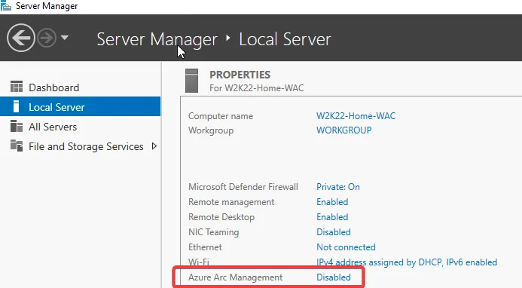

Slide 12
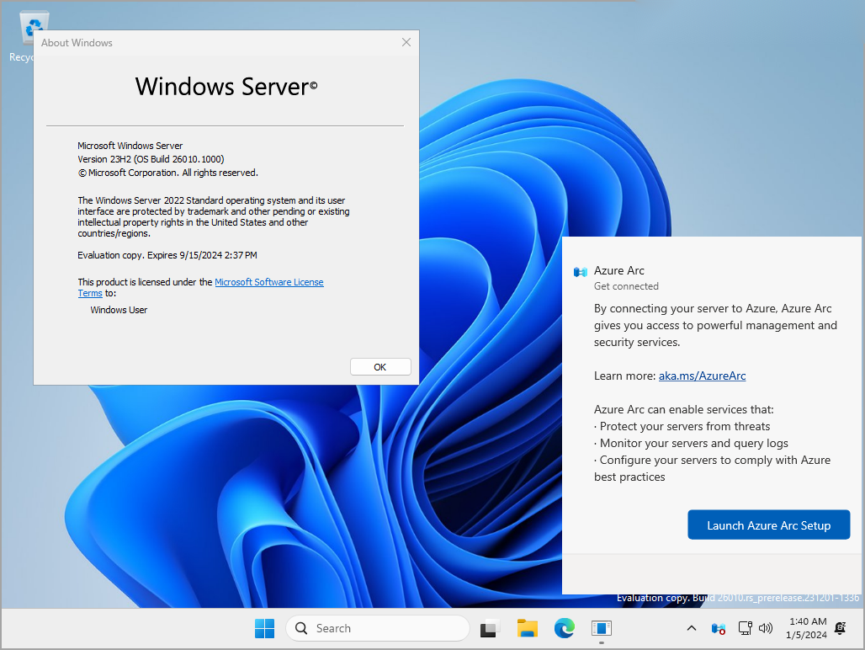
Windows Server 2025 built in Arc Connection Setup

Slide 13
Azure Arc Connection Process
Step
Action
Where
Result
1. Prepare Azure
Create resource group, verify subscription
Azure portal
Azure environment ready
2. Check permissions
Assign Onboarding role to your account
Azure portal / RBAC
Authorised to register servers
3. Register providers
Register HybridCompute, GuestConfiguration, HybridConnectivity
PowerShell or portal
Subscription can accept Arc registrations
4. Generate script
Use Add Server wizard in Azure Arc > Servers
Azure portal
Customised PowerShell script downloaded
5. Run script
Execute script as Administrator on the server
Server - PowerShell (Admin)
Agent installed and server registered
6. Verify connection
Check server appears as Connected in Azure Arc
Azure portal + PowerShell
Server visible with Connected status
7. Review capabilities
Explore Extensions, Updates, Policy tabs
Azure portal
Management features accessible
Windows Server 2025 | Chapter 13 | Azure Arc
10

Slide 14
Generating the Connection Script
Step 1: Prepare Azure
Sign in to portal.azure.com with Contributor or Owner on your subscription
Navigate to Azure Arc using the top search bar
Click Servers in the left menu
Confirm or create a resource group for Arc servers (e.g. WindowsServer-RG)
Step 2: Open the Add Server Wizard
Click + Add to start the wizard
Select Add a single server for a manual, one-by-one connection
Choose your subscription, resource group, and region
Select Windows as the operating system
Add tags to identify the server (e.g. Environment=Lab) if required
Step 3: Generate and Download the Script
Click through the prerequisites check
Click Generate script - a PowerShell script is produced with your subscription details
Click Download to save the .ps1 file to the server or a shared location
Windows Server 2025 | Chapter 13 | Azure Arc
11

Slide 15
Running the Connection Script
What the Script Does — Overview
The generated PowerShell script automates the entire agent installation and registration process
It downloads the Connected Machine agent MSI, installs it, and registers the server with Azure
The process takes 2-5 minutes and requires Administrator rights on the server
On the Server (PowerShell)
1. Open PowerShell as Administrator on LON-SVR1
2. Navigate to the script folder: cd $env:USERPROFILE\Downloads
3. Allow execution: Set-ExecutionPolicy Bypass -Scope CurrentUser -Force
4. Run the script: .\Connect-AzureArc.ps1
What the Script Does
Downloads the Connected Machine agent from Microsoft
Installs the agent as Windows services (himds, GCArcService, ExtensionService)
Registers the server with Azure using your subscription and resource group
After Completion
himds service starts and sends first heartbeat to Azure
Server status changes to Connected in Azure Arc within 2-5 minutes
A managed identity is issued to the server for use by extensions and services
Agent version and metadata are visible immediately in the Azure portal
Server (PowerShell)
Script Actions
Azure Arc Outcome
LON-SVR1
LON-SVR1
LON-SVR1
Azure Portal
Azure endpoints
Azure Arc resource
Azure Resource
Arc service
Azure portal
Admin runs script
Agent installed + server registered
Server visible in Azure Arc
Windows Server 2025 | Chapter 13 | Azure Arc
12

Slide 16
After Connection: What You Can Do
Server is now connected to Azure Arc
Updates
Security
Monitoring
Deploy Azure Monitor Agent
Collect logs and performance data
Audit configuration compliance
Arc-enabled management
Patch and update OS from Azure
Threat detection, vulnerability scanning
Apply Azure Policy
Install monitoring and DSC agents
Run runbooks against the server
Extensions
Compliance
Automation
Run Azure Automation runbooks
Automate patching and config tasks
Key Decision Rules
Explore the Azure Portal
Navigate to Azure Arc > Servers > your server to see all management options including Extensions, Updates, Policies, and Logs.
Enable Key Services
Add extensions for monitoring (Azure Monitor Agent) and security (Microsoft Defender for Servers) from the Extensions blade at no additional Arc cost.
Manage Updates
Use the Updates blade to see pending patches and schedule deployment windows. Azure Update Manager is included free for Arc-connected servers.
Apply Governance
Assign Azure Policy initiatives to enforce security baselines and track compliance across all Arc-enabled servers from one pane of glass.
Windows Server 2025 | Chapter 13 | Azure Arc
13

Slide 17
Verifying and Troubleshooting
Verifying the Connection in Azure Portal
Go to Azure Arc > Servers in the portal
The server appears with Status: Connected (green indicator)
Click the server name to view: OS, IP address, agent version, last heartbeat
Use the Updates blade to see available Windows patches
Use the Extensions blade to see installed and available VM extensions
Verifying the Agent on the Server
# Confirm himds service is running
Get-Service -Name himds |
Select Name, Status
# Show full Arc connection details
azcmagent show
[Screenshot placeholder: Connected Windows Server 2025 machine shown in Azure Arc > Servers with Status: Connected and server details visible]
Common Issues and Fixes
Script fails to download agent
Verify outbound HTTPS access to Azure endpoints from LON-SVR1
Check proxy or firewall rules for TCP 443
Status shows Disconnected after install
Confirm himds is Running: Get-Service himds
Review log: %ProgramData%\AzureConnectedMachineAgent\Log\himds.log
Server not visible in portal
Wait 2-5 minutes after script completion for registration to propagate
Confirm correct resource group and subscription were used in script
Execution policy blocks the script
Run: Set-ExecutionPolicy Bypass -Scope CurrentUser -Force
Windows Server 2025 | Chapter 13 | Azure Arc
14

Slide 18
Chapter Summary
01 Azure Arc extends Azure management to any server without migrating it to the cloud
02 The Connected Machine agent is lightweight, registers the server, and maintains a heartbeat
03 Management capabilities include updates, security, monitoring, policy, and automation
04 Connecting a single server is straightforward: generate a script in the portal, run it as admin, verify the connection

Slide 19
Knowledge Check
1
What is Azure Arc-enabled servers, and how does connecting a machine change how it appears in Azure?
2
What Windows service is the core of the Azure Connected Machine agent, and what does it do?
3
Name two management capabilities available to a server after it is connected to Azure Arc.
4
What role must your Azure account have to register a server with Azure Arc?
Windows Server 2025 | Chapter 13 | Azure Arc
17

Slide 20
PRACTICE LAB
Lab 1301
Connecting Windows Server to Azure Arc
In this lab, you will connect LON-SVR1 to Azure Arc using the portal wizard and a generated PowerShell script. You will verify the connection and explore management capabilities available in the Azure portal.
Windows Server 2025 | Chapter 13 | Azure Arc
18

